Slide 1
Marijuana Cannabis
It’s not that dope
Mel McKune and Julia Jacobson

Slide 2
Street Names
Weed
Pot
Grass
Dope
Mary Jane
Herb
Aunt Mary
Jolly Green
Ganja
Broccoli
(DEA and The Truth About Marijuana Video)

Slide 3
Labels
Marijuana is a mind-altering drug
THC is the main chemical ingredient that produces the psychoactive effect (DEA)
It is legal here, but not in all states
Club drug
Organic
Hallucinogen (The Truth About Marijuana Video)
Not all types of marijuana fall into one category, different types have different effects
Gateway drug
(National Institute on Drug Abuse)

Slide 4
Short-Term Effects
The chemical in marijuana, THC, spreads to nerve cells in organs throughout the body, including the brain, causing difficulty in
Memory
learning
cognitive and physical coordination
Confusion and hallucinations
Blood-shot eyes
Headaches
Increased blood pressure ("Drug Fact Sheet").

Slide 5
Long Term Effects
Using marijuana for a long period of time can lead to
Amotivational Syndrome: which includes apathy, lack of judgement, and difficulty in setting goals and making decisions.
Bronchitis and emphysema
Increased risk of lung cancer
Increased risk of depression
Suppression of the immune system
Can lead to an earlier onset of depression and schizophrenia in teens ("Drug Fact Sheet").

Slide 6
Forms of Marijuana
Liquid: Consumed by tinctures
Hash
http://www.drugfreeworld.org/real-life-stories/marijuana.html
http://www.drugfreeworld.org/real-life-stories/marijuana.html

Slide 7
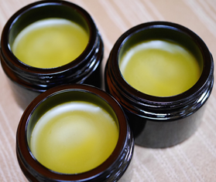
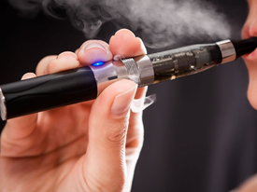
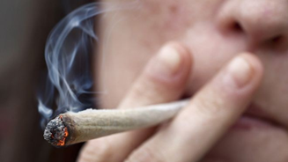
Methods of Consumption
Lotions and Balms
Smoking and Vapor
Marijuana is usually smoked as a cigarette (called a joint) or in a pipe.
It is also smoked in blunts, which are cigars that have been emptied of tobacco and refilled with marijuana
http://www.drugfreeworld.org/real-life-stories/marijuana.html
http://www.drugfreeworld.org/real-life-stories/marijuana.html

Slide 8
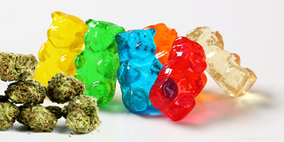
Methods for Consumption
Pills or capsules
Edibles
https://herb.co/2017/09/20/gummy-bear-edibles-california/
https://herb.co/2016/02/01/step-step-guide-making-cannabis-pills/

Slide 9
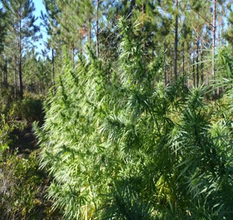
Methods for Consumption
Bath Salts
Marijuana in its natural form
http://www.drugfreeworld.org/real-life-stories/marijuana.html
https://www.dea.gov/ops/cannabis.shtml

Slide 10
Effects on Community
Increased visits to emergency rooms related to marijuana use
Increased demand for rehabilitation treatment
Teens who use marijuana can be more inclined to use heroin later in life
Teens who use marijuana are more likely to get into fights with their peers, steal, and destroy property
Users are more likely to be violent towards community members and also more likely to commit crimes
Driving under the influence of Marijuana- threat to other drivers ("The DEA Position on Marijuana").

Slide 11
Other Information
Grown in US, Canada, Mexico, South America, and Asia ("Drug Fact Sheet").
Washington was the second state to legalize Marijuana ("The DEA Position on Marijuana").
In WA, if you are 21 or older you can purchase marijuana
In Washington adults may only possess 1 ounce of Marijuana
Colorado allows Marijuana to be grown at home, which WA does not allow
Despite Marijuana being legal for medicinal purposes in all states, Marijuana is not legal under federal law ("The DEA Position on Marijuana").

Slide 12
Video!
http://www.drugfreeworld.org/real-life-stories/marijuana.html

Slide 13
Works Cited
“The DEA Position on Marijuana.” The DEA Position on Marijuana, www.dea.gov/docs/marijuana_position_2011.pdf.
“How Marijuana Is Consumed.” Drug Policy Alliance, Drug Policy Alliance, www.drugpolicy.org/drug-facts/10-facts-about-marijuana/how-marijuana-consumed.
“Is Marijuana a Gateway Drug?” National Institute On Drug Abuse, National Institute On Drug Abuse, www.drugabuse.gov/publications/research-reports/marijuana/marijuana-gateway-drug.
“Drug Fact Sheet.” Marijuana, www.dea.gov/druginfo/drug_data_sheets/Marijuana.pdf.
“The Truth About Marijuana.” The Truth About Marijuana, Foundation For a Drug-Free World, www.drugfreeworld.org/real-life-stories/marijuana.html.
Abuse, National Institute on Drug. “Is Marijuana a Gateway Drug?” NIDA, www.drugabuse.gov/publications/research-reports/marijuana/marijuana-gateway-drug.
DEA. “Drug Fact Sheet: Marijuana .” Drug Enforcement Administration , www.dea.gov/druginfo/drug_data_sheets/ Marijuana.pdf.
“How Marijuana Is Consumed.” Drug Policy Alliance, www.drugpolicy.org/drug-facts/10-facts-about-marijuana/how- marijuana-consumed.
“TRUTH ABOUT MARIJUANA VIDEO - Real Life Stories - Side Effects of Marijuana, Cannabis and Hashish Facts.” Foundation for a Drug-Free World, www.drugfreeworld.org/real-life- stories/marijuana.html.

Slide 14
THC is not for me!
You don't mariJUANA try it!

